Slide 1



Change Maker Workshop: complexity and public services
Max French, Newcastle Business School, Northumbria University

Slide 2

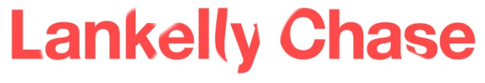
Today:
A rant about why public / non-profit management is broken
Then we’ll explore some work taking a different approach

Slide 3
UK public finances
Funding for local government through the Revenue Support Grant will have shrunk 77% by 2020 (Local Government Association)
£2.5bn shortfall in social care by 2020 (The King’s Fund)
Now: local government bankruptcy, significant funding gaps in Manchester, Liverpool, Bristol, Birmingham…

Slide 4
A typical story
https://tangledandtrapped.wordpress.com/author/5daypwblog/page/1/

Slide 5
Things to notice
Every contact makes the situation worse, not better, for both parties
For the person: increasing frustration, despondency, poverty
For the public sector: up-front and long-term costs
Notes:
How is Sally doing now?
Have our interactions helped Sally live a better life?

Slide 6
People’s lives are complex…
Their situations are individual and unique.
Their circumstances are prone to change
Their needs are diverse and interconnected

Slide 7
… but we pretend they are not
Standard operating procedures
Performance targets
Specialisation
Economies of scale

Slide 8
Why? Bad management theory creates bad management practice
The public and third sector workforce are lazy, shirking, conniving and opportunistic.
So they need to be incentivised to work, monitored, audited

Slide 9
Commissioners/budget holders
Write tenders, promote competition, buy outcomes/impact
Managers
Line manage and assign accountabilities, pursue strategic agenda
Practitioners
Carry out duties efficiently, quickly, effectively

Slide 10
So what is the alternative?

Slide 11
3 Workshops:
Practitioners
Commissioners
Managers
Gateshead
Plymouth
York
Q1 - how has the work deviated from a ‘standard’ job role?
Q2 – what permissions are needed to work in this way?
Q3 – what knowledge is needed to work in this way?

Slide 12
People’s needs are…
So, services need to be…
Individual
Changeable
Interconnected
Tailored to individual circumstances
Responsive and adaptive
Joined up and collaborative

Slide 13
Practically, this means
Use performance measures for learning, NOT accountability
Design service interventions from the bottom-up, NOT (just) what is ‘evidence-based’, ‘best practice’
Work in the long term, population and place-level, not merely individual services, teams, interventions.

Slide 14
What’s possible
Gateshead: practitioner-led, bespoke service interventions for council tax ‘debtors’
York: multi-agency complex needs network, providing place-leadership
Plymouth: integration of four commissioning strategies, £80 million pooled budget using alliance contract

Slide 15
Have any questions?
Got any ideas?
Let’s keep the conversation going…
Max.French@northumbria.ac.uk

