Slide 1

Social Power
Sue Tibballs, SMK CEO
www.smk.org.uk
@SMKCampaigners

Slide 2

About SMK.
We believe people should be able to shape their world. We exist to help them do just that. We do this by:
  Building capacity – training, coaching and consultancy to help build the confidence and capacity of people and organisations to effect change
  Convening and advocating – bring campaigners together to share learning, support collaboration and speak with one voice. Conduct an annual Campaigner Survey and ad hoc research and advocacy
  Celebrating – host the annual National Campaigner Awards
Notes:
Intro to SMK

Slide 3
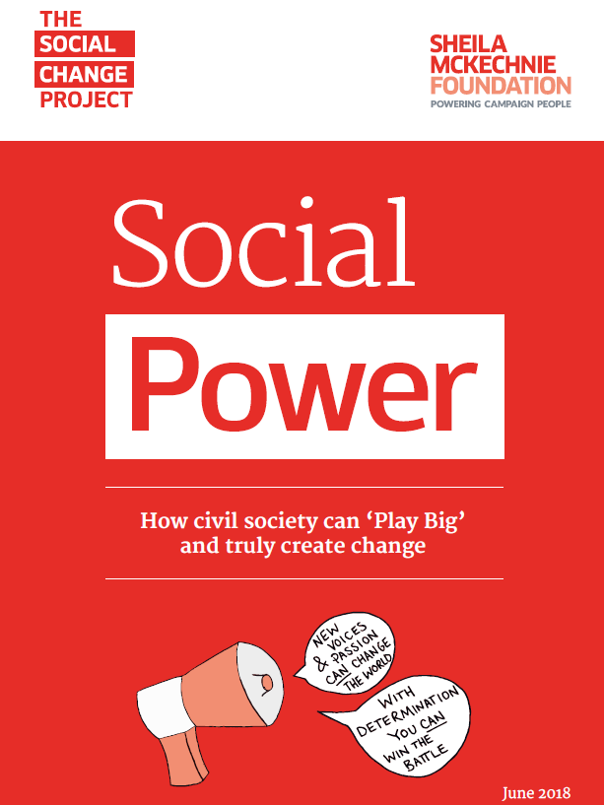

Slide 4
7 funders
18 months
1 project manager
1 design team
3 phases
16 events
400 strong Community of Practice
8 strong Advisory Board
1 BIG question…

Slide 5
“What can we learn about how
social change is happening today
that can strengthen civil society’s
future efforts?”

Slide 6
How is civil society involved
in social change?

Slide 7
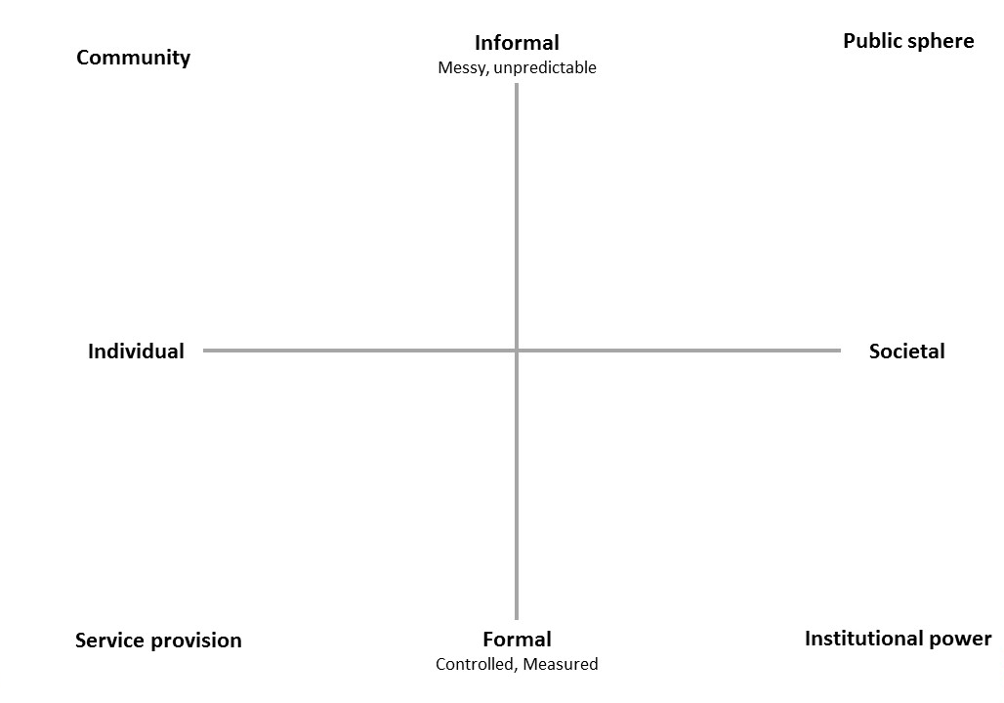
The Social Change Grid

Slide 8
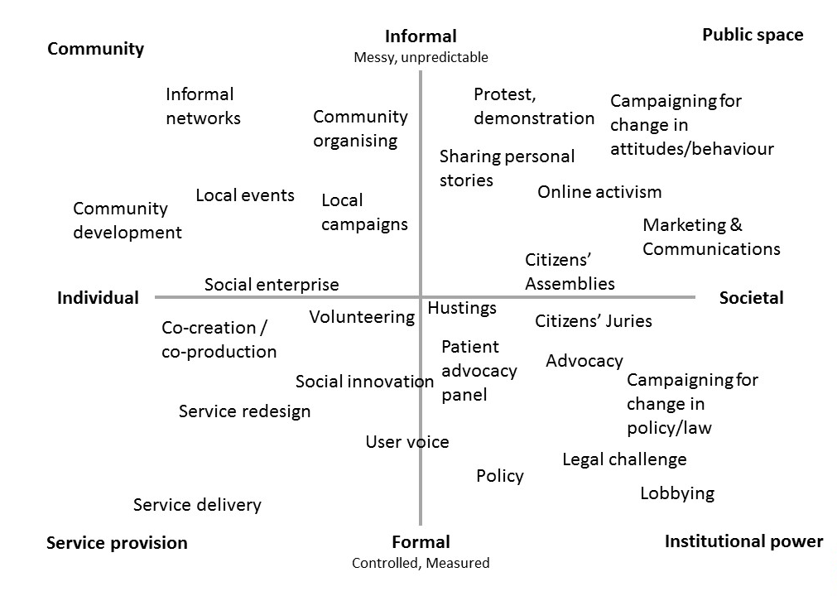

Slide 9
Findings #1
Is change being driven more by top half of the grid?
Is innovation in bottom left being scaled – so reaching bottom right?
As voice gets louder in top right, being constrained in bottom left
Also, civil society lacks a common identity and language.

Slide 10
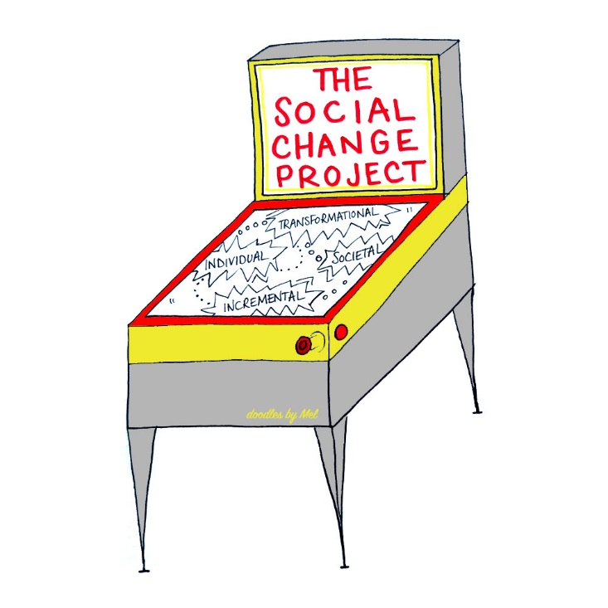
How is significant change
happening?

Slide 11


The Living Wage
Informal
Messy, unpredictable
Public sphere
Community
Living Wage becomes a mainstream idea
START
Citizens UK brings together communities from religious institutions, schools etc. – low pay is a big issue
Community organising and direct action e.g. demonstrations or pickets
Public appetite grows amid economic crisis, rising living costs and stagnating wages
Other employers see the reputational benefits of accreditation and numbers rise
Testimony of individual low-paid workers
Living Wage Foundation continues to campaign for a ‘real’ Living Wage
Individual
Societal
Living Wage Foundation established to formally accredit employers
Mayor of London and Leader of Labour Party support campaign
Employers must pay ‘National Living Wage’
Employers such as London Olympics pay Living Wage
Government announces its own ‘National Living Wage’ policy
JRF and Loughborough University calculate annual Minimum Income Standard
Service provision
Formal
Controlled, Measured
Institutional power

Slide 12
Grapevine Coventry
Informal
Messy, unpredictable
Public sphere
Community
Community organising, building and bringing in assets and support from community
Social movement approach to mobilise wider community through Grapevine’s approach
& Warwickshire
Individual
Societal
Approach centred on really listening to people, allowing them to articulate what support they need
Attract attention from national funders as an example of ‘Good Help’
START
Grapevine starts to work with individuals whose needs are not adequately met by existing service provision
Grapevine funded to work with more people
Service provision
Formal
Controlled, Measured
Institutional power

Slide 13
#MeToo
Informal
Messy, unpredictable
Public sphere
Community
Women across the world use #MeToo to share their experiences online
START
Activist Tarana Burke uses ‘Me Too’ in her work with women in disadvantaged communities who have experienced sexual abuse
#MeToo used by actress after accusations against Harvey Weinstein, and encourages other women to share their experiences
Individual
Societal
Weinstein Company brought down
Government and other institutions investigate evidence of abuse
Service provision
Formal
Controlled, Measured
Institutional power

Slide 14
Findings #2
Civil society drives change by witnessing and amplifying lived experience - and by believing things can and should be better/different
Civil society works in ways and goes to places the state finds difficult
Government needs civil society to drive social change

Slide 15
SOCIAL POWER!
“Social Power is the capacity civil society has to deliver transformational change – in individual lives, in communities and in society as a whole“

Slide 16

What makes some things succeed
Where others fail?

Slide 17
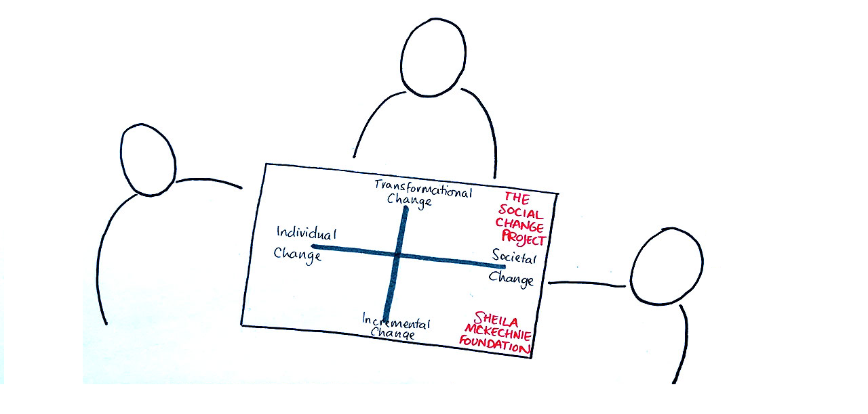
The Twelve Habits of Effective
Change-Makers

Slide 18
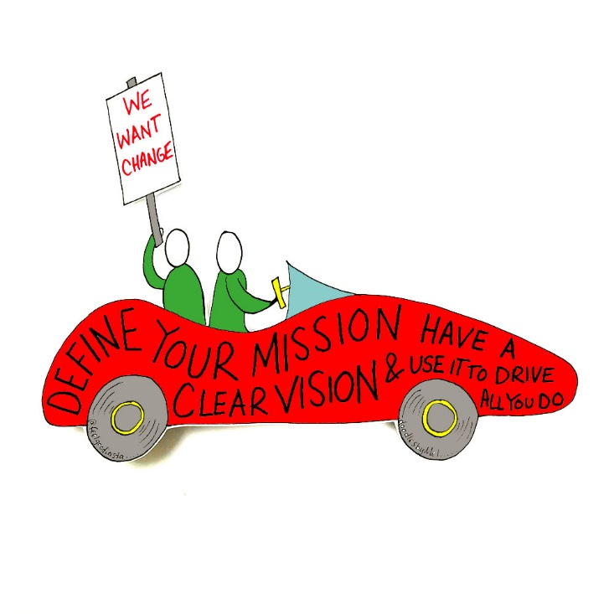
#1 Mission first, not model or money
“Shared vision is vital for the learning organisation because it provides the focus and energy for learning – generative learning occurs only when people are striving to accomplish something that matters deeply to them.”
Peter Senge The Fifth Discipline

Slide 19
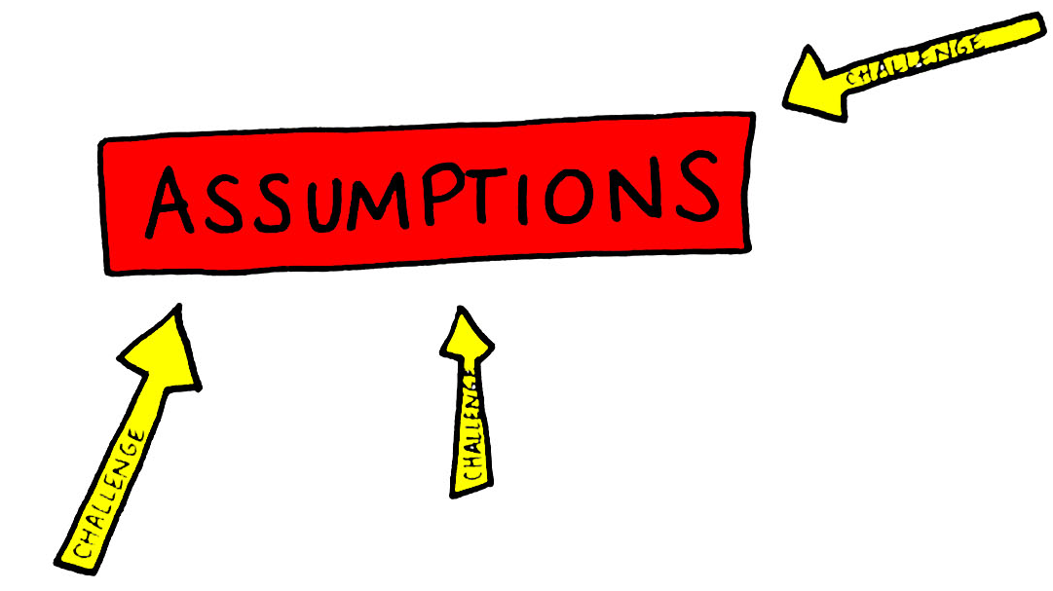
#2 Looking at the bigger picture
“You have to work hard at it, whether that means rigorously analysing a system or rigorously casting off your own paradigms and throwing yourself into the humility of not-knowing. In the end, it seems that mastery has less to do with pushing leverage points than it does with strategically, profoundly, madly, letting go and dancing with the system”
Donatella Meadows, Thinking in Systems: A Primer

Slide 20
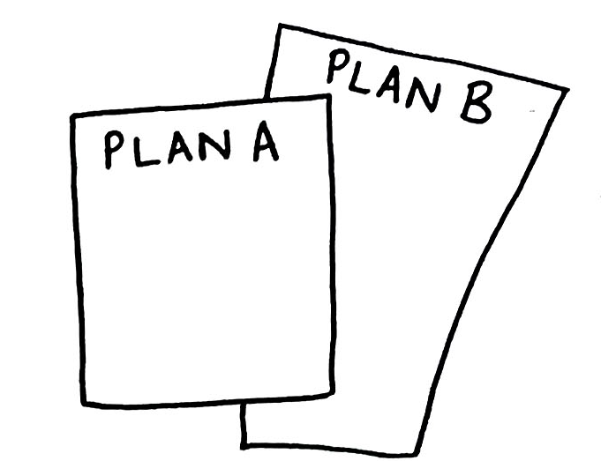
#3 Being adaptive and responsive
“Events, dear boy, events”
Harold MacMillan, British Prime Minister, 1957 – 63

Slide 21
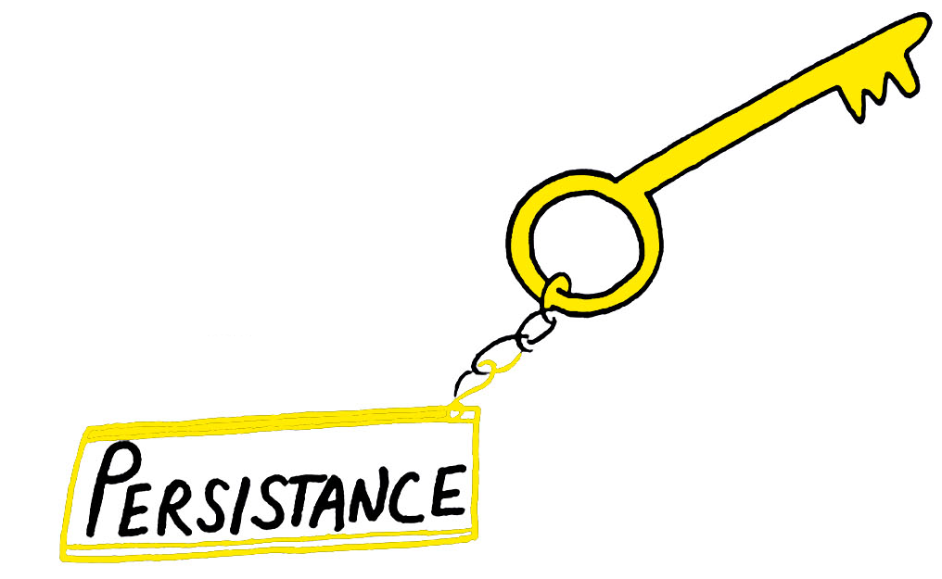
#4 Persistence, perseverance and resilience
“There is a myth that creating deep-seated social change is somehow all about winning...organising is all about resilience. You’ll get hit in every direction you can imagine – but if you keep getting up, and trying again, eventually you’ll win.”
Emily May, Hollaback!

Slide 22
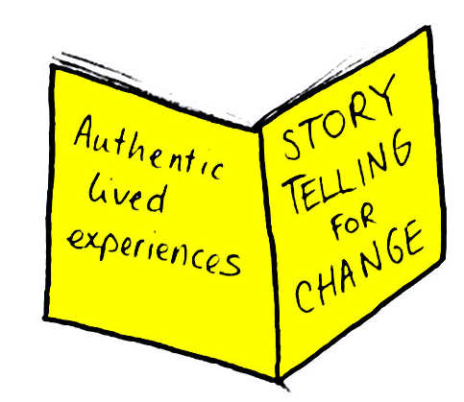
#5 In whose name?
“Nothing about us, without us.”

Slide 23

#6 Primacy of relationships
“What could not have been foreseen at the outset was the way [it] would create capacity for change of all kinds. Deep, extensive networked relationships have been created that provide the infrastructure for innovation, and naturally regenerate in the face of challenges and in response to demand.”
Darnton A & Harrison A: a Re-Valuation of Grapevine – Good to Go

Slide 24
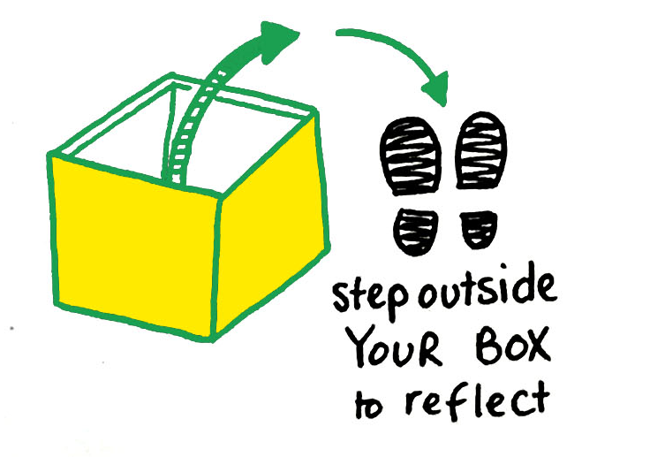
#7 Understanding other people’s interests and motivations
“I don’t like that man. I must get to know him better.”
Abraham Lincoln

Slide 25

#8 Radical listening and an asset-based approach
“It takes two to tell the truth: one to speak, and another to listen.”
Henry David Thoreau: American essayist, poet, philosopher and abolitionist

Slide 26
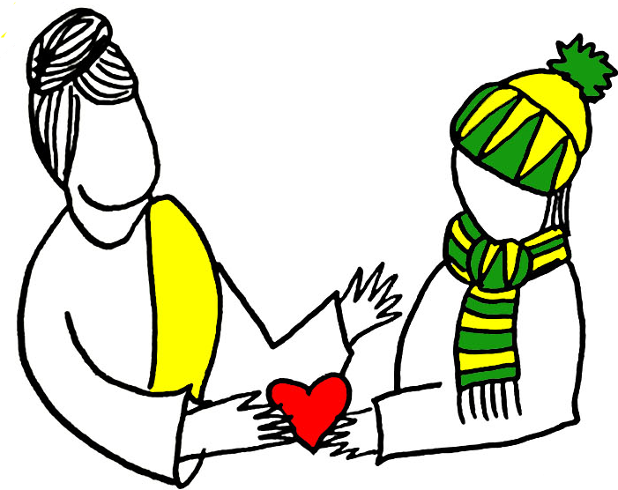
#9 Collaborating rather than competing
“When the campaign is designed to be open from the beginning, to function more like a hashtag and shared rallying point for a wider coalition of independent actors, this enables a shift from cause campaign to wider social movement, and the result is often much greater impact and reach.”
Netchange

Slide 27
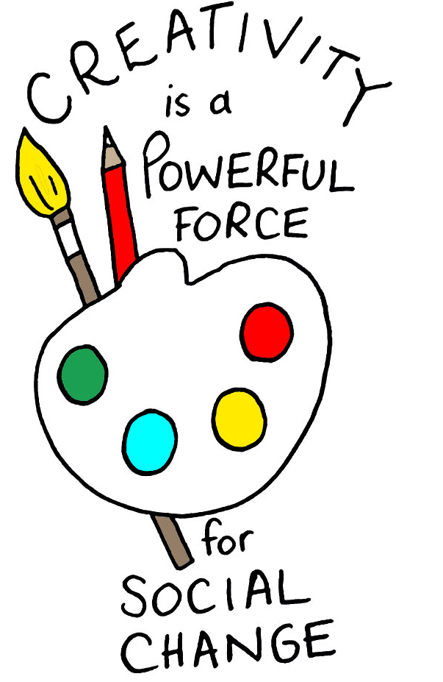
#10 Knowing our tools

Slide 28

#11 Evaluating what matters and learning from it
“Reflection is an integral part of the work activists to, because it is at the point at which they can step back and learn from their experiences…Group reflection is about…understand[ing] the value of collective action and develop[ing] a sense of the power they can build…Private reflection develops the individual’s sense of personal agency and identity as an activist”
Hahrie Han: How Organizations Develop Activists

Slide 29
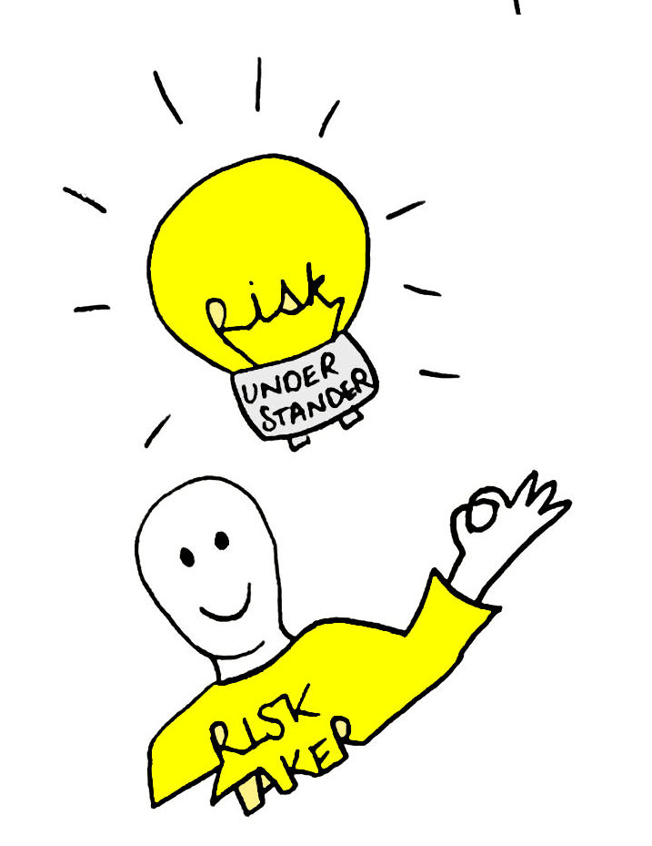
#12 Take responsible risks
“First, try new things, expecting some will fail. Second, make failure survivable: create safe spaces for failure and move forward in small steps…And third, make sure you know when you’ve failed, or you will never learn”
Tim Harford, Adapt

Slide 30
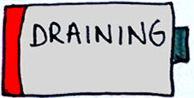
What is holding society back?
1
Lack of a clear social change model/too narrow a focus
2
Internal integration
3
An overly constraining performance management model
4
A lack of resources, support and encouragement
5
An internal culture in the sector based around commissioning and a market-based model
6
Not ensuring our legitimacy – in whose name?
7
A lack of bold leadership
8
Constraints to voice
9
Not recognising our true value
10
Being funded in ways that support this

Slide 31
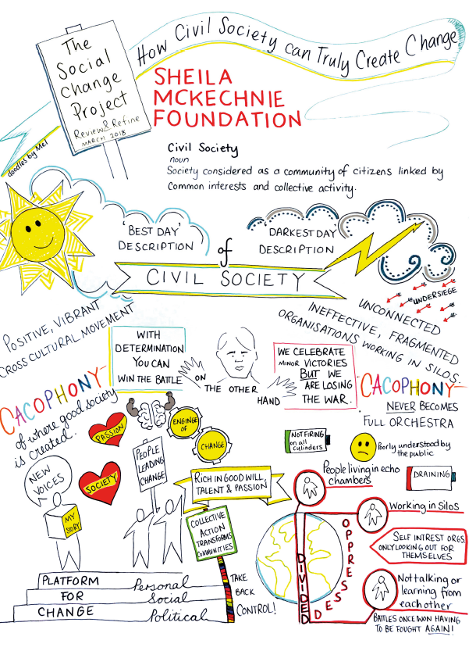



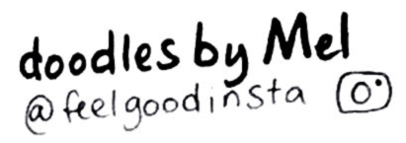
www.smk.org.uk
@SMKCampaigners
info@smk.org.uk

